Slide 1
Computational model of cancer stem cell dynamics
Submitted By
Rahul Kulkarni
CE, Dept of CS & E,
SJCE, Mysore.
Guide
Dr.M.A.Anusuya
Assistant Professor,
Dept of CS & E,
SJCE, Mysore.
Panel
Mrs. Manjula.S
Assistant Professor,
Dept of CS & E,
SJCE, Mysore.

Slide 2
Introduction
Supervised learning , Unsupervised learning
The K-means algorithm is a method to automatically cluster similar data examples together.
Principal Component Analysis (PCA) performs dimensionality reduction by finding a direction (a vector) onto which to project the data so as to minimize the projection error.

Slide 3
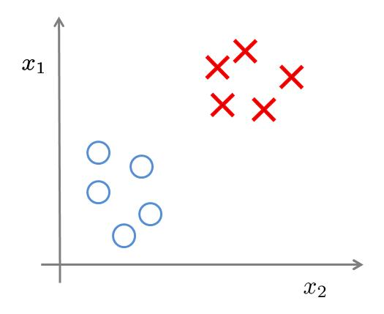
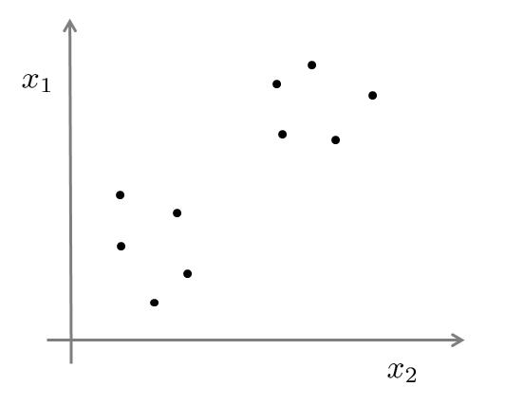

Learning
Supervised learning | Unsupervised learning
Training set:

Slide 4
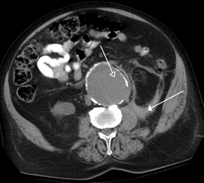
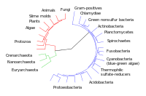
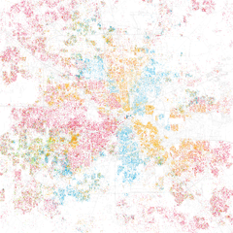
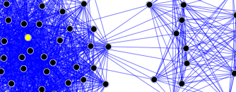
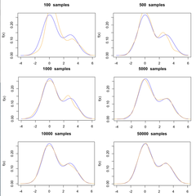
Applications of clustering
Biology, computational biology and bioinformatics | Medicine
Business and marketing | World wide web
Computer science | Social science

Slide 5
Clustering
K-means algorithm
Input:
  K (number of clusters)
  Training set

Slide 6

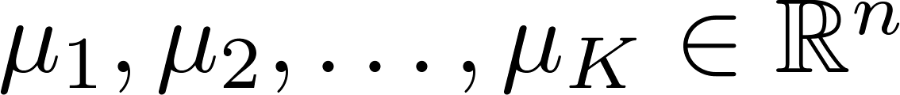
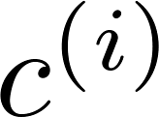
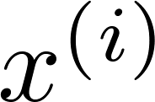



K-means algorithm
Randomly initialize cluster centroids
Repeat {
for = 1 to
:= index (from 1 to ) of cluster centroid
closest to
for = 1 to
:= average (mean) of points assigned to cluster
}

Slide 7
Results
Comparing among various K
Compression Ratio
Root Mean Square Error

Slide 8
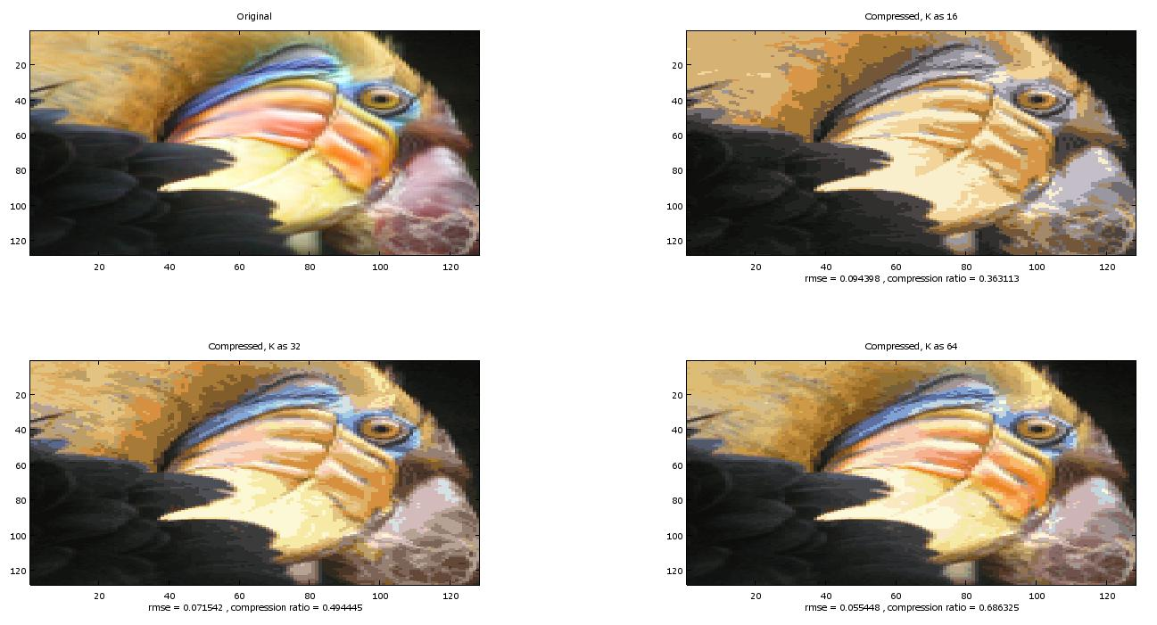
Results

Slide 9
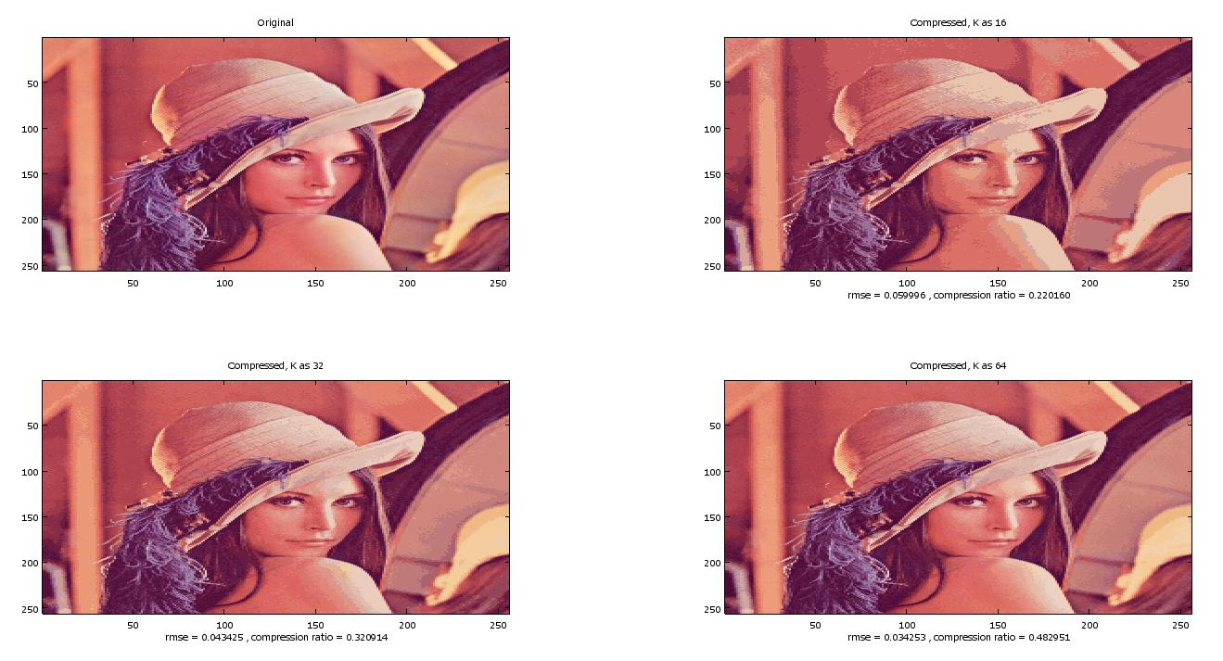
Results

Slide 10
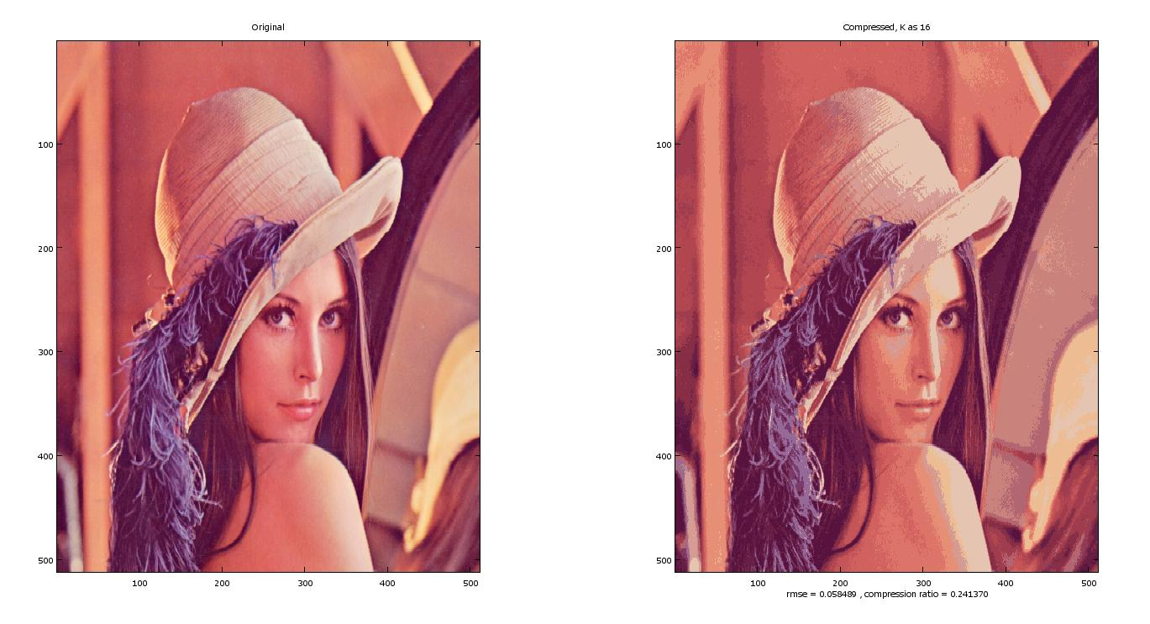
Results

Slide 11
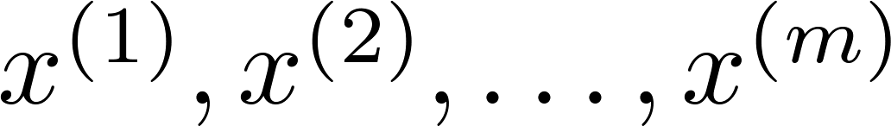
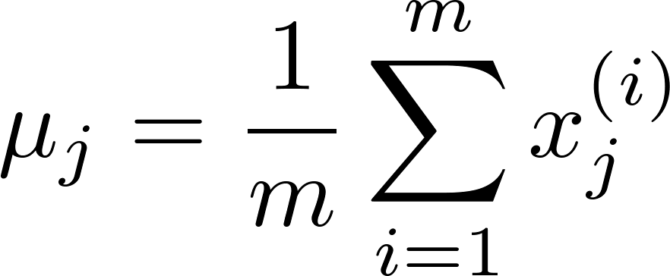
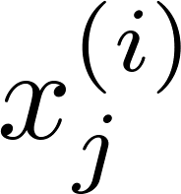

Principal Component Analysis
Difference in Linear regression and PCA
Data preprocessing
Training set:
Preprocessing (feature scaling/mean normalization):
Replace each with
If different features on different scales , scale features
to have comparable range of values.

Slide 12
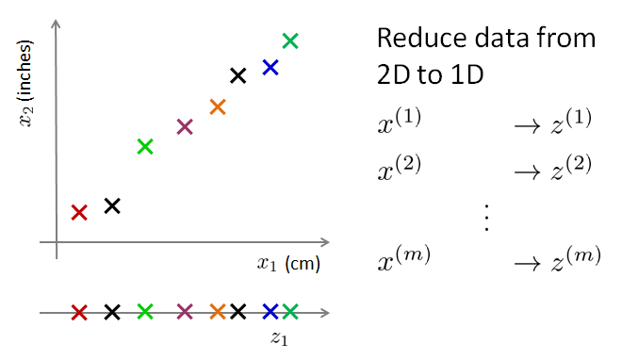
Data Compression

Slide 13


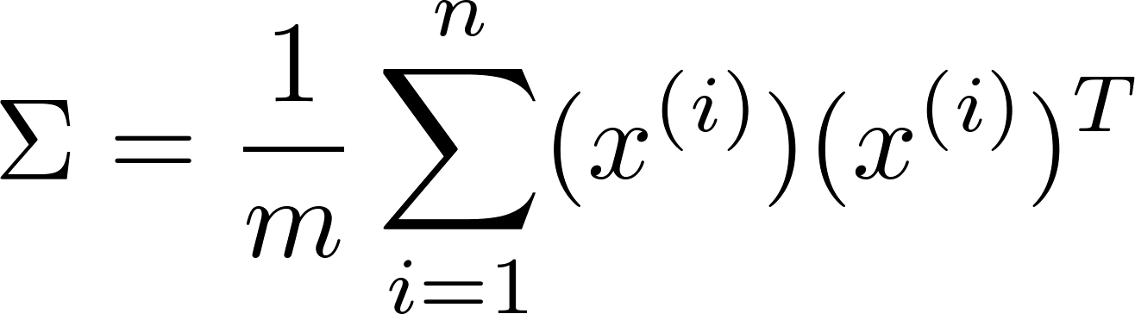

Principal Component Analysis (PCA) algorithm
Reduce data from - dimensions to - dimensions
Compute “covariance matrix”:
Compute “eigenvectors” of matrix :
[U,S,V] = svd(Sigma);
Ureduce = U(:,1:k);
z = Ureduce’*x;

Slide 14
Applications
Supervised learning speedup
Reduce memory/disk needed to store data
Visualization

Slide 15
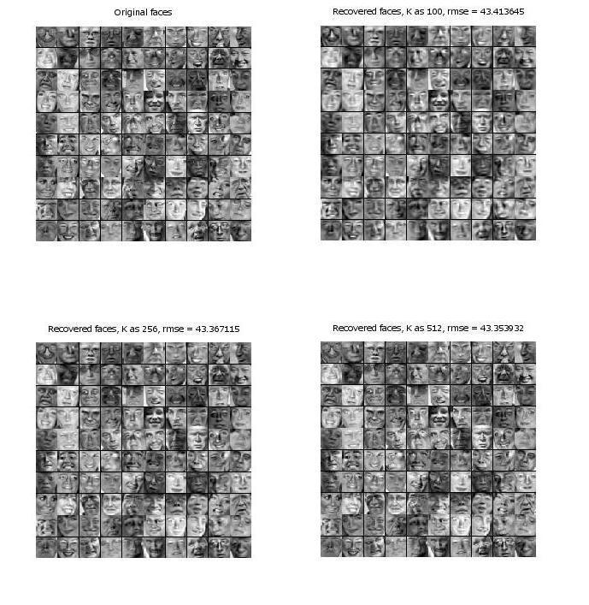
Results

Slide 16
Supervised Learning
Use the reduced dimension results of K means and PCA in Classification by Logistic Regression
Logistic regression to recognize handwritten digits (from 0 to 9)
Dataset : subset of the MNIST handwritten digit dataset (http://yann.lecun.com/exdb/mnist/)
Compare algorithm performance on original and reduced dimensions.

Slide 17
Reference
Machine Learning by Andrew Ng: https://class.coursera.org/ml
Octave: http://www.gnu.org/software/octave/doc/interpreter/Matrix-Factorizations.html, http://octave.sourceforge.net/octave/function/svd.html
Images :
Frank Wouters
Lena Söderberg , Dwight H
Fringe, Warner
Dataset:
Cropped version (http://conradsanderson.id.au/lfwcrop/) of the labeled faces in the wild (http://vis-www.cs.umass.edu/lfw/) dataset.

Slide 18

Results

Slide 19
Dataset:
Subset of the MNIST handwritten digit dataset (http://yann.lecun.com/exdb/mnist/)
http://en.wikipedia.org/wiki/File:CollapsedtreeLabels-simplified.svg#filelinks
http://en.wikipedia.org/wiki/File:RupturedAAA.png
http://en.wikipedia.org/wiki/File:Race_and_ethnicity_Houston.png
http://en.wikipedia.org/wiki/File:SNA_segment.png
http://en.wikipedia.org/wiki/Cluster_analysis#Applications

Slide 20
THANK YOU

